Slide 1
QUB GIFT CITY DATATHON 2026
Where should Gujarat invest
₹6,500 crore in tourism?
An evidence-based allocation for economic growth, jobs, regional inclusion and sustainability.
₹6,500 cr
33
4
~143k
budget
districts
objectives
jobs modelled
Notes:
[~20s] The question is simple but the stakes are high: Gujarat — India's third-largest foreign-tourist destination, in its declared Year of Tourism — must place ₹6,500 crore to maximise four goals at once: growth, jobs, regional inclusion, and sustainability. We built a transparent engine to answer exactly where. In five minutes: the opportunity, our method, the allocation, where it lands, why it's robust, and what to do Monday morning.

Slide 2
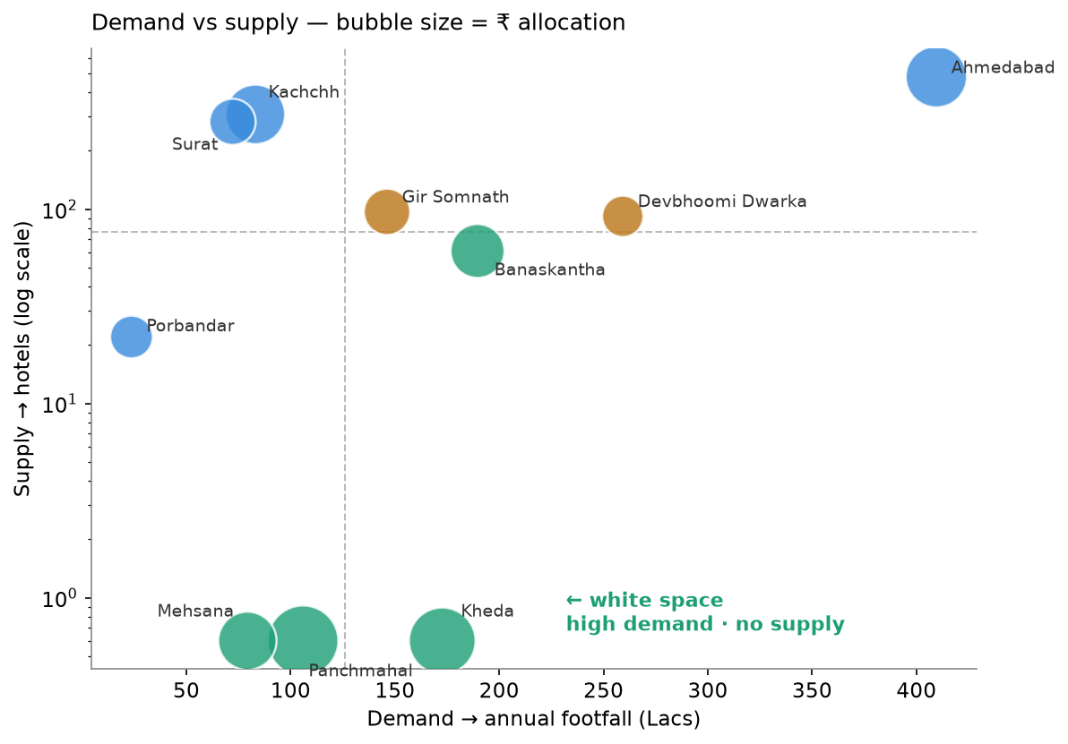
THE OPPORTUNITY GAP
Follow the gap, not the crowd
3
of the top-10 footfall districts have zero hotels in the data — a literal blank canvas.
310,000
visits per hotel in Banaskantha (Ambaji) — the state's least-literate district.
−0.25
correlation of footfall with hotel quality — the busiest hubs deliver the worst experience.
Notes:
[~50s] Most teams will chase footfall. That's a trap. Plot demand against supply and the story flips. Three districts — Panchmahal, Kheda, Mehsana — are top-ten for footfall yet have zero hotels in the data. Banaskantha, home to the Ambaji temple, absorbs 310,000 visits per hotel — and it's the least-literate district in Gujarat. And footfall is negatively correlated with hotel quality: the busiest places give the worst experience, exactly the on-the-ground problem the brief flags. The opportunity isn't where tourists already are — it's where demand outruns supply in districts that also need development.

Slide 3
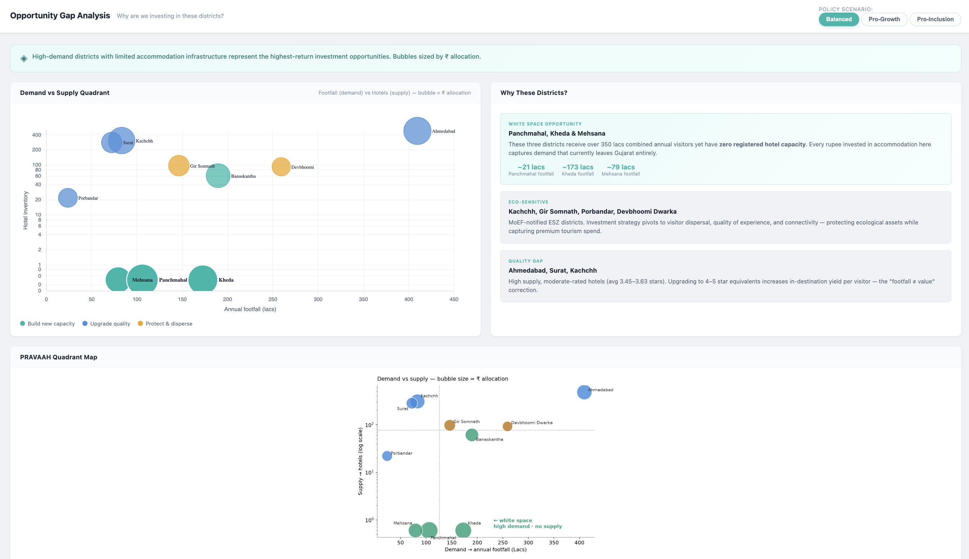

Slide 4
THE FRAMEWORK
PRAVAAH — a transparent allocation engine
1
2
3
4
→
→
→
SCORE
CONSTRAIN
ALLOCATE
STRESS-TEST
every district on four objectives
inclusion floor + carrying-capacity cap
₹6,500 cr across districts & levers
500 weightings + frontier
Economic
Employment
Inclusion
Sustainability
yield-adjusted
jobs / crore
inverse literacy
congestion + eco
Four objectives, scored at step 1 — every parameter cited and tunable. No black box.
Notes:
[~40s] Our framework, PRAVAAH, is deliberately a glass box, not a black box — judges trust what they can audit. Four steps. One: score every district on four objectives — economic value (yield-adjusted, because a pilgrim day-tripper is not a premium eco-tourist), employment, inclusion, and sustainability. Two: constrain — a 30% floor for the least-literate districts and a carrying-capacity cap so we never overload a fragile eco-zone. Three: allocate the budget across districts and four investment levers. Four: stress-test against 500 weightings. Every number is sourced from WTTC, the Tourism Satellite Account, and the Census.

Slide 5
THE RECOMMENDATION
Three moves, four levers
BUILD THE WHITE SPACE
LIFT THE LEFT-BEHIND
PROTECT & DISPERSE
₹2.3k cr
₹1.0k cr
₹0.7k cr
Panchmahal, Kheda, Mehsana — new capacity + connectivity where demand has no supply.
Banaskantha & Dahod — inclusive flagship: skilling, decongest Ambaji, raise quality.
Dwarka & Gir Somnath — cap new build in eco-zones, spread visitors, manage carrying capacity.
Across four levers:
₹2,122 cr
₹1,685 cr
₹1,500 cr
₹1,194 cr
Build
Upgrade
Protect & disperse
Skilling & sustainability
Notes:
[~50s] Run the engine and here is what it recommends — three moves. One — build the white space: 2.3 thousand crore into Panchmahal, Kheda and Mehsana, where demand has no supply, paired with connectivity so the rooms get used. Two — lift the left-behind: a thousand crore into Banaskantha and Dahod, the inclusion flagship, with skilling, decongestion at Ambaji and quality upgrades. Three — protect and disperse: 700 crore at Dwarka and Gir Somnath to cap new build in eco-zones and spread visitors. And it's not all hotels — across four levers, the largest slice after build is upgrading the experience, and a quarter goes to skilling and sustainability, which is where inclusion and jobs actually land.

Slide 6
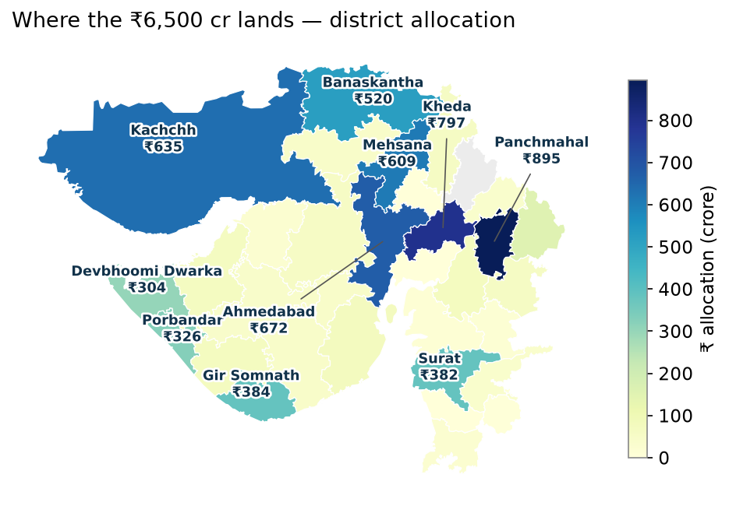
GEOGRAPHIC ALLOCATION
₹6,500 crore, on the map
~143,000
jobs created (98k–228k)
37%
of budget to low-literacy districts
₹895 cr
to Panchmahal — zero hotels today
85% to evidenced districts · 15% ring-fenced for data-blind districts.
Notes:
[~55s] Geographically, here is where it lands. The budget flows east and into the under-served interior, not just the big cities. Panchmahal leads at 895 crore — a UNESCO World Heritage site, Champaner-Pavagadh, with zero formal hotels today. Kheda and Mehsana follow on the same logic. Ahmedabad still gets money, but for quality upgrades, not new build. The headline: about 143,000 jobs — a sourced range, not a single hopeful number — and 37% of every rupee reaching the least-literate districts, which the model produced on merit before the equity floor even bound. And we're honest about the data: 85% goes where we have footfall evidence; 15% is ring-fenced to explore the districts we're blind on.

Slide 7
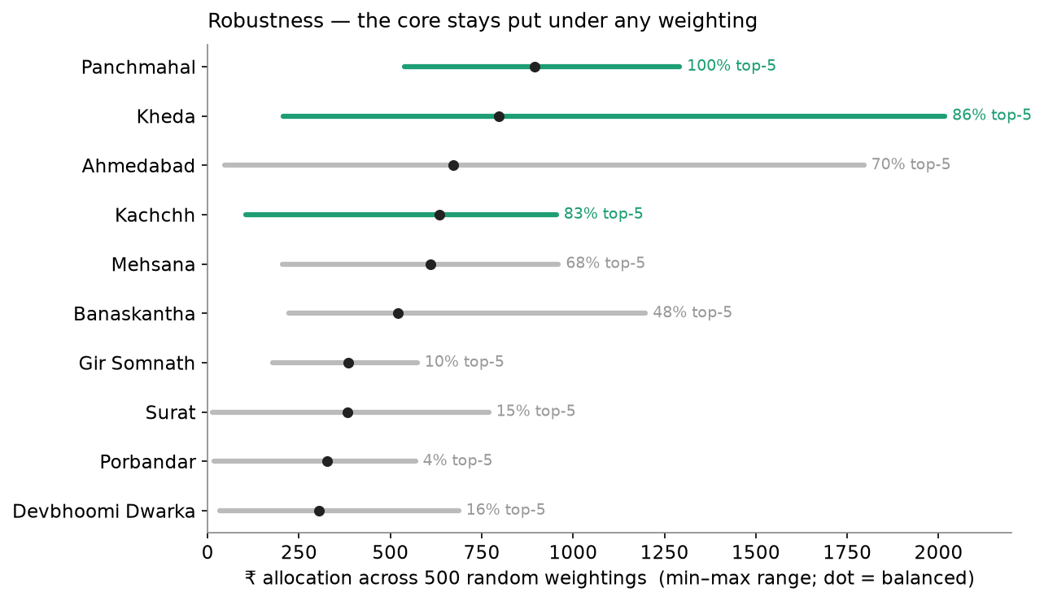
ROBUSTNESS
The recommendation holds under any weighting
100%
Panchmahal stays top-5 across 500 random weightings
5.1%
allocation variation within plausible policy bands
Weight-invariant — not cherry-picked.
Notes:
[~40s] A judge's first question for any weighted index is: did you tune the weights to get the answer you wanted? We pre-empted it. We re-ran the allocation under 500 random weightings spanning the entire policy space. Panchmahal lands in the top five in 100% of them; Kheda and Kachchh, over 80%. Within realistic policy bands the whole allocation moves just 5%. The teal districts are weight-invariant — the core recommendation is a property of the data, not of our assumptions. The grey districts swing interpretably: Ahmedabad rises if you prioritise growth, Banaskantha if you prioritise inclusion.

Slide 8
FROM BUDGET TO IMPACT
A phased plan for inclusive growth
NOW — 18 mo
18 — 48 mo
4 — 7 yr
Quick wins
Build the white space
Scale & explore
Quality upgrades in Ahmedabad & Surat; decongest Ambaji & Dwarka.
Capacity + connectivity in Panchmahal, Kheda, Mehsana.
Activate data-blind districts; monitor carrying capacity.
~143k
37%
100%
jobs created
to low-literacy districts
eco-capped, weight-tested
Transform data into decisions that create meaningful impact.
Notes:
[~45s] Finally, delivery. This is phased, not a one-shot cheque. Now to eighteen months: quick wins — upgrade quality in the big hubs and decongest the crowded temples. Eighteen to forty-eight months: build the white space with capacity and the roads and rail to reach it. Years four to seven: activate the data-blind districts and monitor carrying capacity so growth stays sustainable. The payoff: roughly 143,000 jobs, 37% of the budget reaching the least-literate districts, and every rupee eco-capped and weight-tested. That is how Gujarat turns ₹6,500 crore — and its data — into inclusive, sustainable growth. Thank you.

Slide 9
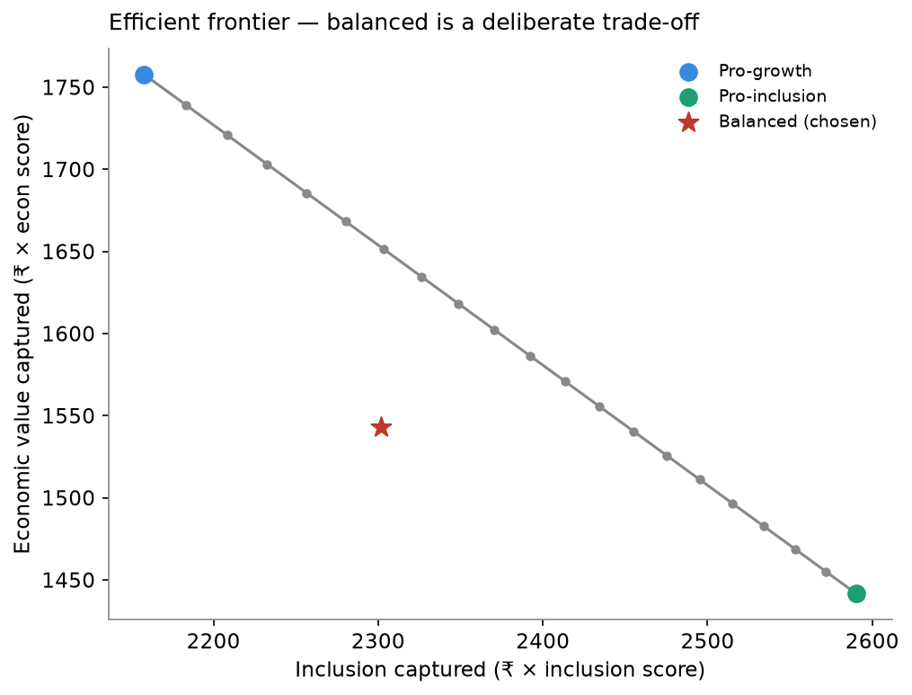
APPENDIX A1
Efficient frontier & model assumptions
Why balanced? The frontier maps the economic–inclusion trade-off; balanced (red star) is a deliberate, defensible compromise — not a corner solution.
Employment: 22 jobs / ₹cr central, 15–35 range (WTTC India 2024: 46.5M jobs / ₹21tn).
Yield: relative spend tiers — pilgrimage ₹800 → eco-premium ₹6,000 (the footfall ≠ value fix).
Inclusion: 2011 Census literacy (relative ranking); 30% floor to bottom-quartile districts.
Sustainability: congestion (visits / hotel) + Gujarat's six notified Eco-Sensitive Zones.
Budget split: 85% evidenced (footfall) / 15% exploration (22 data-blind districts).
Notes:
Appendix — not spoken. The efficient frontier justifies the balanced stance; the five parameters are the model's external assumptions, each cited on the next slide.

Slide 10
APPENDIX A2
References & data sources
Competition datasets — QUB GIFT City Datathon 2026
Government & institutional sources
Hotel & accommodation dataset
Ministry of Tourism, Govt. of India — India Tourism Statistics
Gujarat tourism statistics (orig. Commissioner of Tourism, Gujarat)
World Travel & Tourism Council (WTTC) — Economic Impact Report 2024
Gujarat census dataset
Tourism Satellite Account (TSA) of India
Census of India 2011
Geospatial
Eco-Sensitive Zone notifications — MoEFCC / Gujarat Forest Dept.
Gujarat district GeoJSON — india-maps-data (Survey of India base)
All sources listed were directly used in the analysis. No other datasets were incorporated.
Notes:
Appendix — not spoken. Only sources actually used in the PRAVAAH analysis are listed.

Slide 11
APPENDIX A3
Tools & technologies
Analytics & modelling
Visualisation
Python · Pandas · NumPy · openpyxl
Matplotlib
Geospatial analysis
Presentation development
GeoPandas · Shapely · GeoJSON
PptxGenJS · python-pptx
Robustness testing
Framework
Monte Carlo simulation (Dirichlet weight sampling)
PRAVAAH allocation framework
Project resources & validation. Public government and institutional reports (Ministry of Tourism, WTTC, India TSA, Census 2011) were used to harden the model's assumptions. Literature-informed multipliers — tourism jobs-per-crore and spend-per-visit by segment — were sensitivity-tested across documented ranges, not fixed at single values. Generative AI tools were used to accelerate coding and presentation development; all analyses, assumptions, validation, and recommendations were reviewed and verified by the team.
Notes:
Appendix — not spoken. Only tools actually used are listed (visuals were built in Matplotlib + GeoPandas; the deck in PptxGenJS). AI-disclosure line included — confirm it aligns with QUB submission rules.

Slide 12
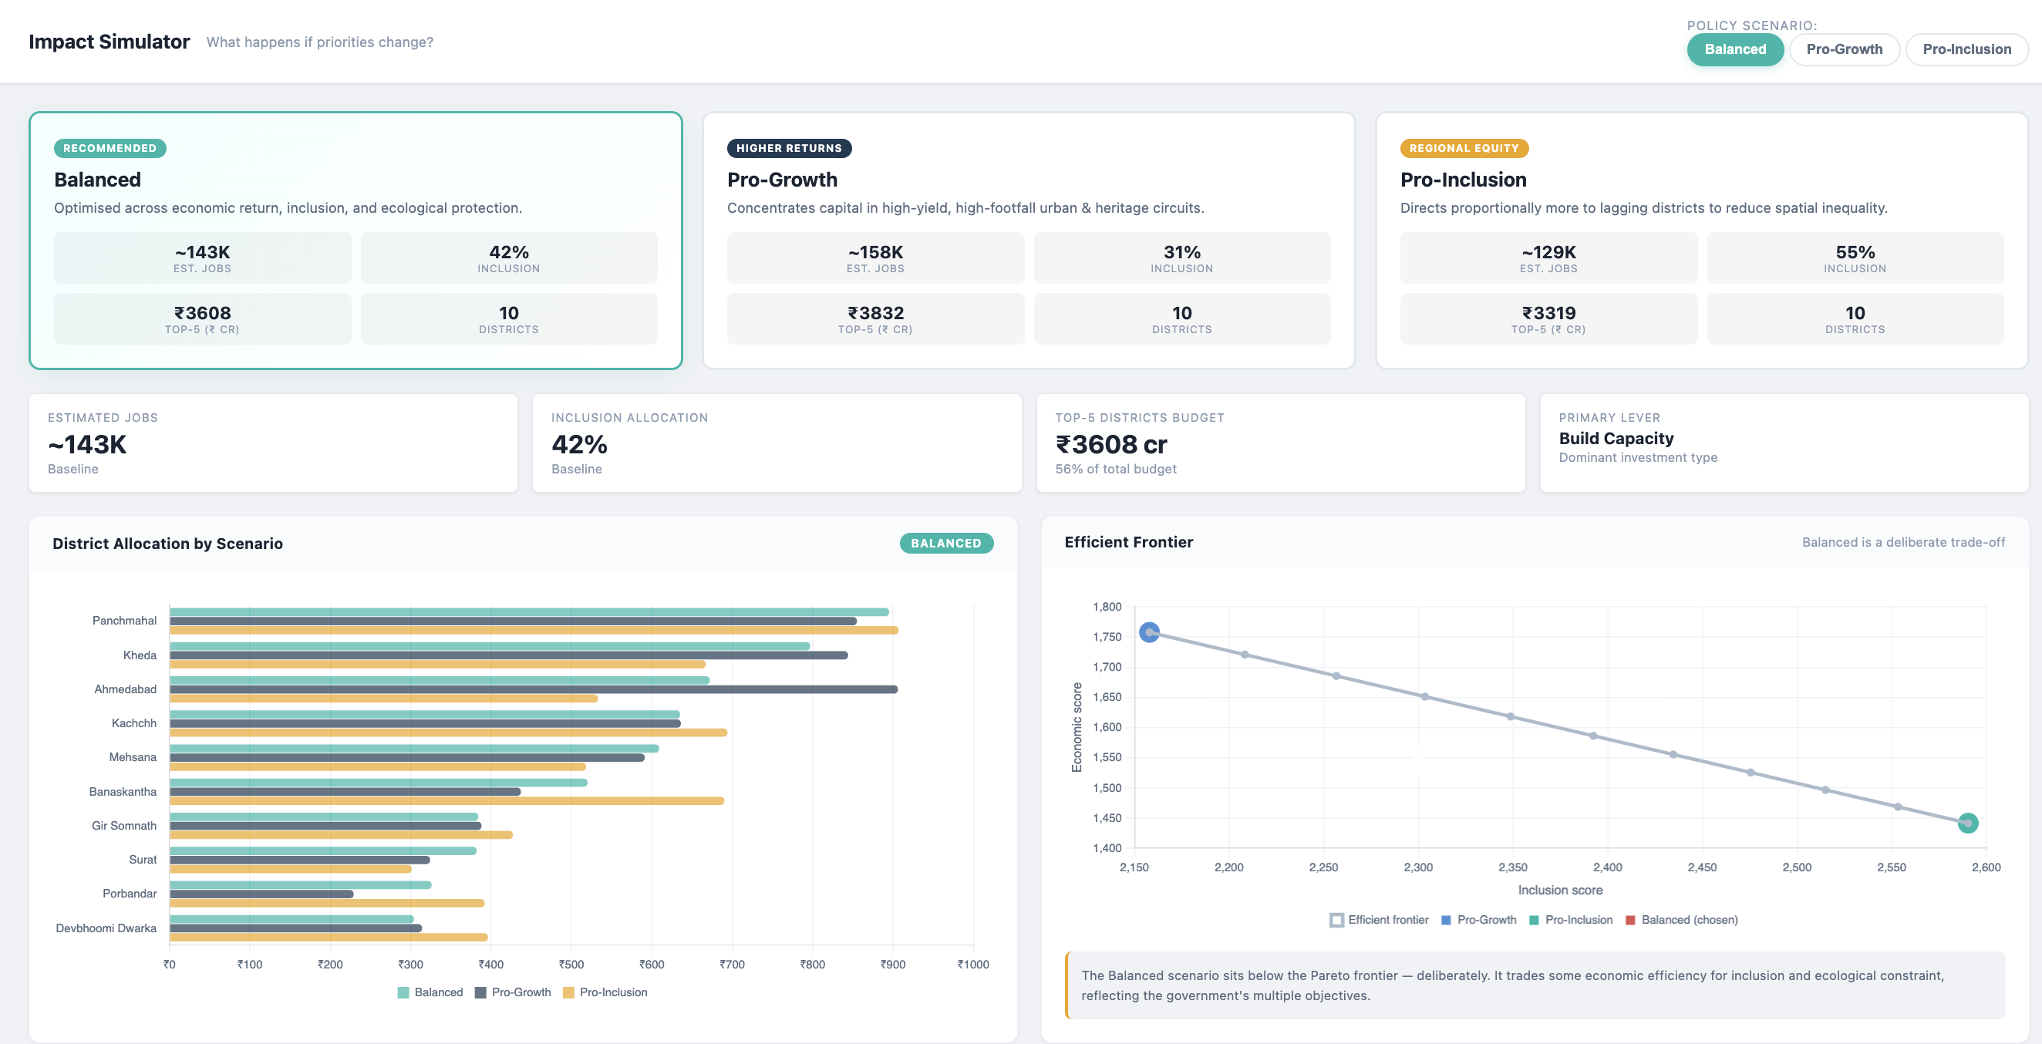

Slide 13


